Slide 1
數值分析Numerical Analysis
許志宇Chin-Yu Hsu
October 1, 2018

Slide 2
聽眾Audience
碩一first year graduate
基礎課程 Basic curriculum
19 students

Slide 3
Objective
引導您了解如何自學。Guide you to know how to learn by yourself.
數值分析（NA）的歷史是什麼？
What is the history of the Numerical Analysis(NA)?
Who are the important people NA? Newton, Lagrange, Gauss and Euler.
What are the important events of NA?
Where is the location of NA?
Which objects are related to NA?
When is NA popular?

Slide 4
材料Materials
What is NA
Python Language
Tensor flow
Project and report

Slide 5
程序Procedure

Slide 6
Introduction
Step by step to learn small concepts by doing
A project and report should be done by yourself
1 5 mins
15 mins
50 mins
15 mins
75 mins
Demo:How to solve problem?
Conclusions

Slide 7
家庭作業1/Homework1
Learning efficiency depends on motivation
Why do you choose this course?
What kind of jobs for NA?
What kind of jobs you want?
How to learn knowledge of NA efficiently?
Python programming
Mathematics
Tensorflow, scikit learn and, karas

Slide 8
Python programming
Learning topics
Using Python as a Calculator
Arithmetic operations
Variables
if Statements
for Statements
The range() Function
Executing modules as scripts
Mathematics
Python Functions - W3Schools
Learning Resources
Welcome to Python.org
Download
Python For Beginners
The Python Tutorial
IntroductoryBooks
Python Functions - W3Schools
A Visual Introduction to Python
Try Jupyter

Slide 9
Python programming
Learning topics
Python Functions
def my_function(): print("Hello from a function") my_function()
Learning Resources
Python Functions - W3Schools
Run web python or Anaconda
http://jupyter.org/try
https://hub.mybinder.org/user/jupyterlab-jupyterlab-demo-yqivt6ba/lab#Integration-(scipy.integrate)

Slide 10
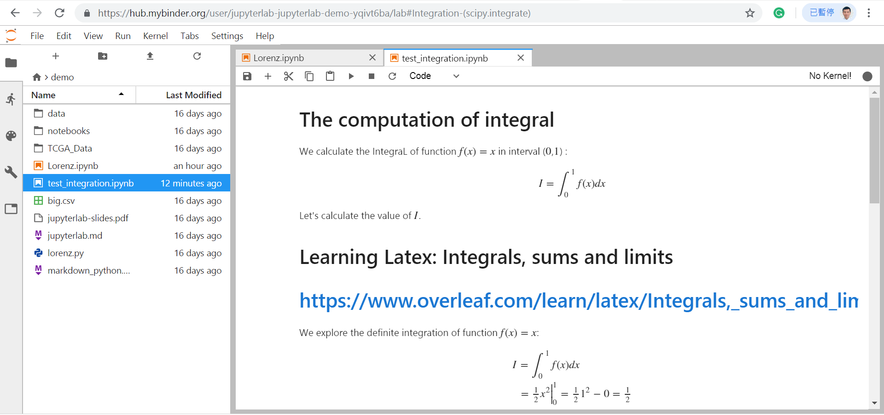
Python programming
http://jupyter.org/try

Slide 11
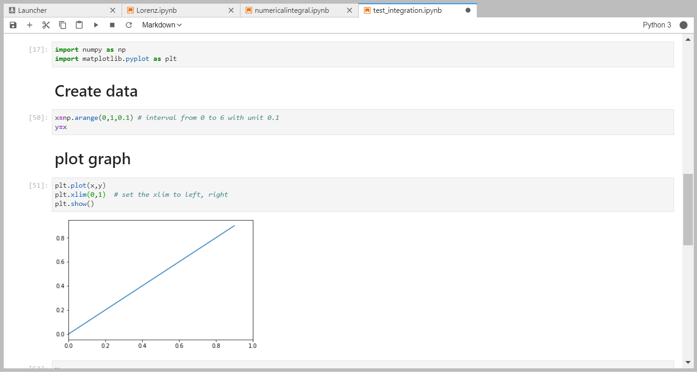
Python programming
Plot graph curve y=f(x)=x
import numpy as np
import matplotlib.pyplot as plt
# Create data
x=np.arange(0,1,0.1) # interval from 0 to 6 with unit 0.1
y=x
# plot graph
plt.plot(x,y)
plt.xlim(0,1) # set the xlim to left, right
plt.show()
http://jupyter.org/try

Slide 12
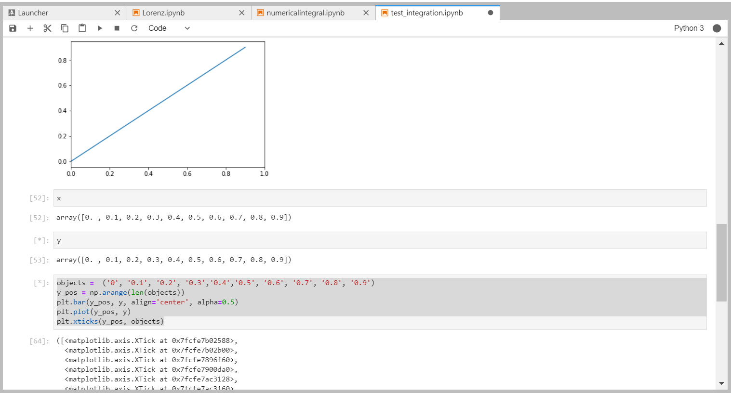
程式設計 Python programming
Data
X
y
http://jupyter.org/try

Slide 13
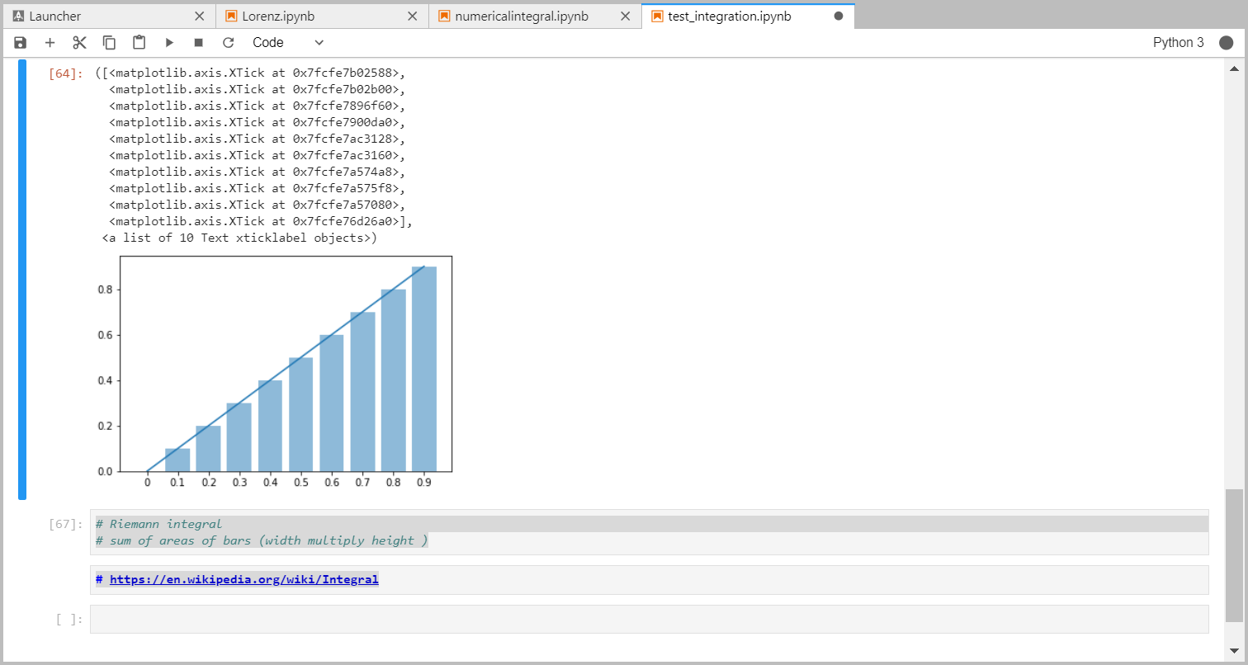
程式設計 Python programming
Bar Plot
# Riemann integral
# sum of areas of bars (width multiply height )
# https://en.wikipedia.org/wiki/Integral
objects = ('0', '0.1', '0.2', '0.3','0.4','0.5', '0.6', '0.7', '0.8', '0.9')
y_pos = np.arange(len(objects))
plt.bar(y_pos, y, align='center', alpha=0.5)
plt.plot(y_pos, y)
plt.xticks(y_pos, objects)
http://jupyter.org/try

Slide 14
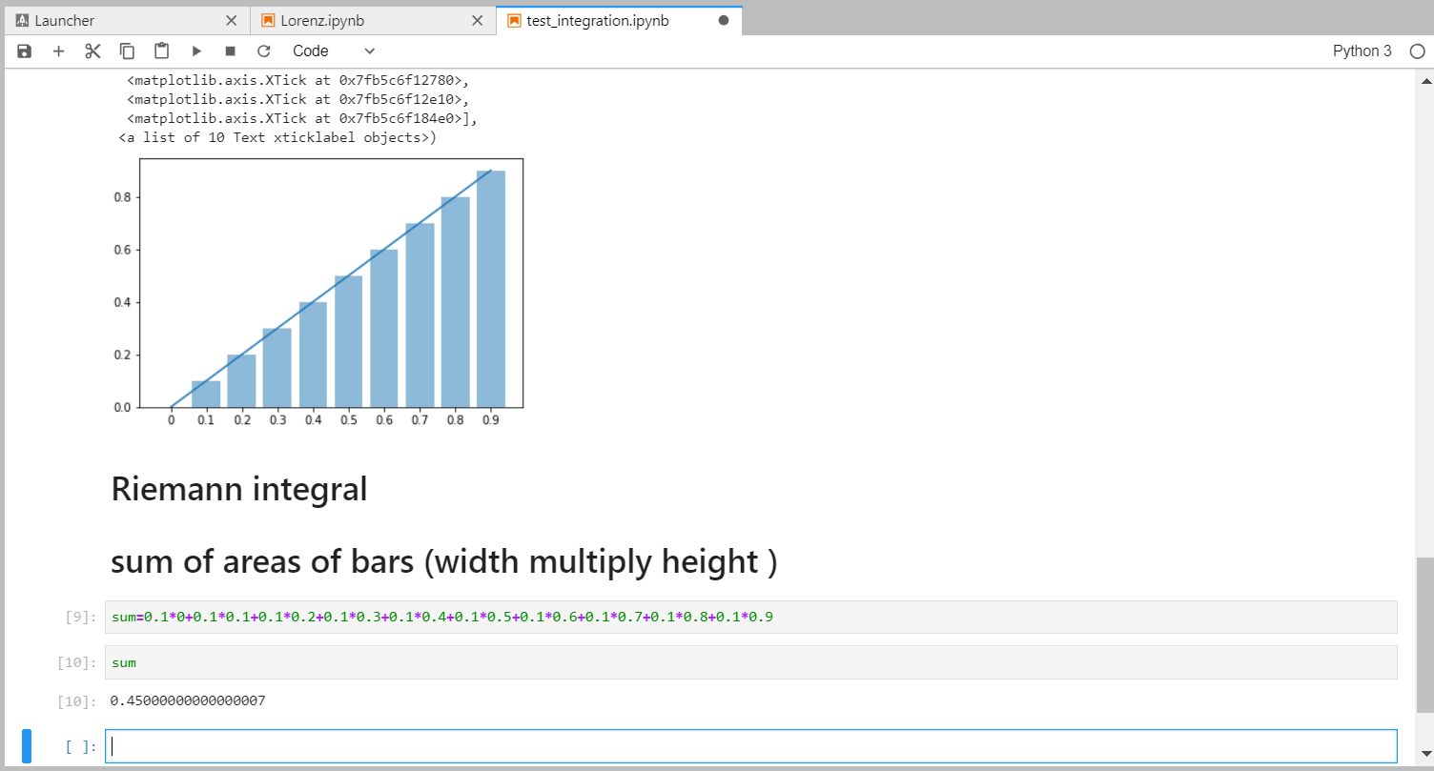
Python programming
# Riemann integral
# sum of areas of bars (width multiply height )
# https://en.wikipedia.org/wiki/Integral
https://en.wikipedia.org/wiki/Numerical_integration

Slide 15
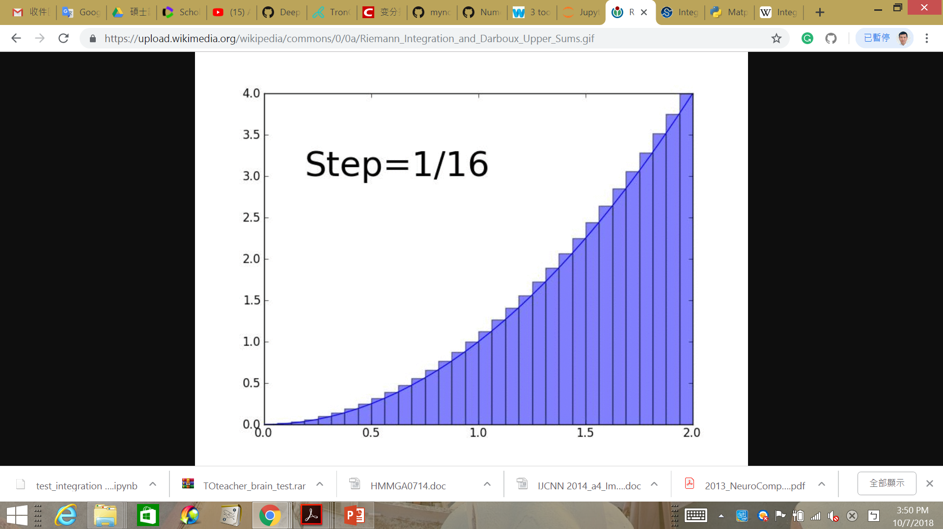
Python programming
Question:
Y=x**2 [0 1]
Summing the areas of these rectangles, we get a better approximation for the sought integral, namely
https://docs.scipy.org/doc/scipy/reference/generated/scipy.integrate.quad.html
https://en.wikipedia.org/wiki/Integral

Slide 16
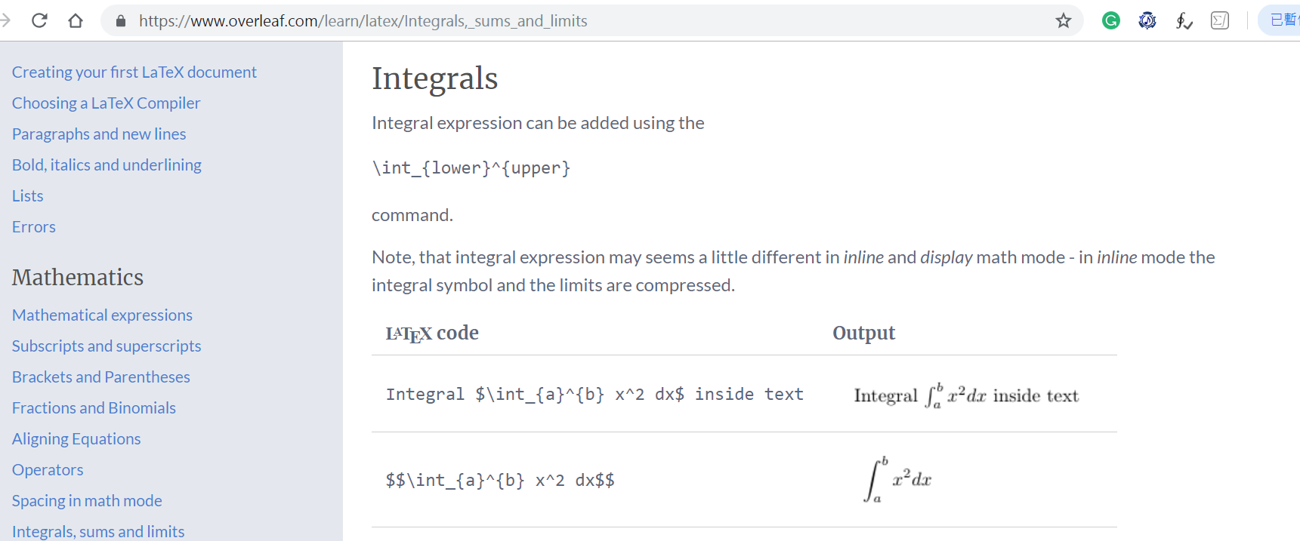
Latex programming
Learning to Latex to Integrals, sums and limits
https://www.overleaf.com/learn/latex/Integrals,_sums_and_limits

Slide 17
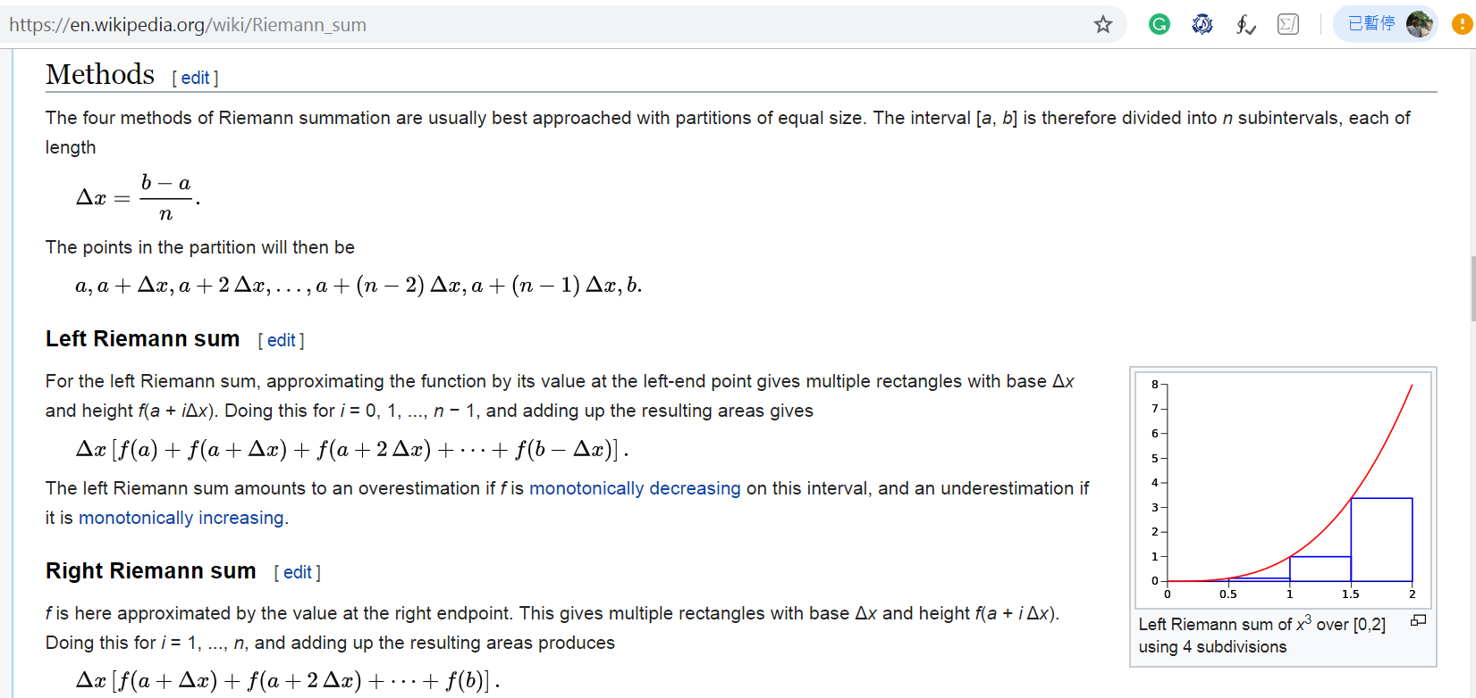
Python programming
Learning to implement the algorithm on wiki
https://en.wikipedia.org/wiki/Riemann_sum

Slide 18
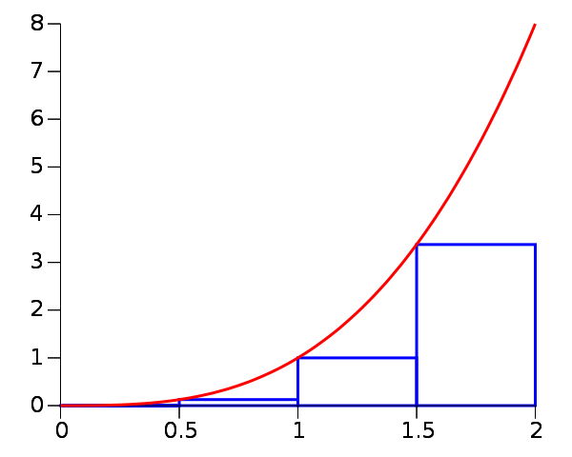
Python programming
Question:
Refer to:
https://github.com/tccnchsu/Numerical_Analysis/blob/master/NA_W4_Integration.ipynb
F(x)=x^2#
https://en.wikipedia.org/wiki/Riemann_sum

Slide 19
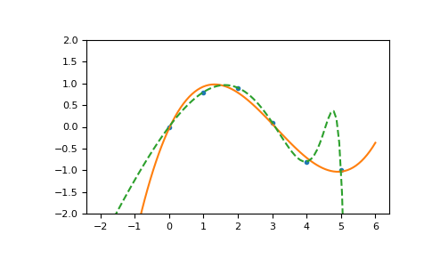
Python programming
polynomial interpolation
Two points <-> 2,3,4 degree polynomial
Three points <-> 2,3,4 degree polynomial
Four points <-> 2,3,4 degree polynomial
https://docs.scipy.org/doc/numpy-1.15.0/reference/generated/numpy.polyfit.html

Slide 20
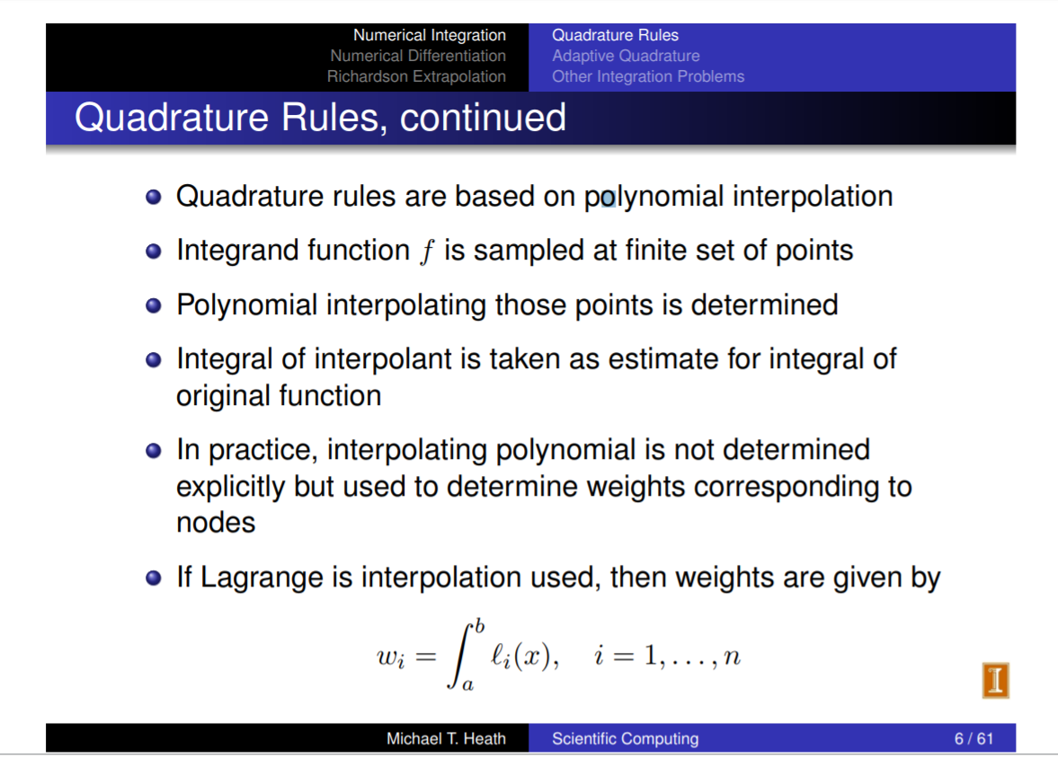
Python programming
We will see two types of global (interpolatory) rules:
– Newton-Cotes — interpolatory on uniformly spaced nodes.
– Gauss rules — interpolatory on optimally chosen point sets.
https://relate.cs.illinois.edu/course/cs450-f17/file-version/f753d2d1a50ecbf2ca66202aa894e6d67c24efdb/lecture-notes/chap08_lec2.pdf

Slide 21
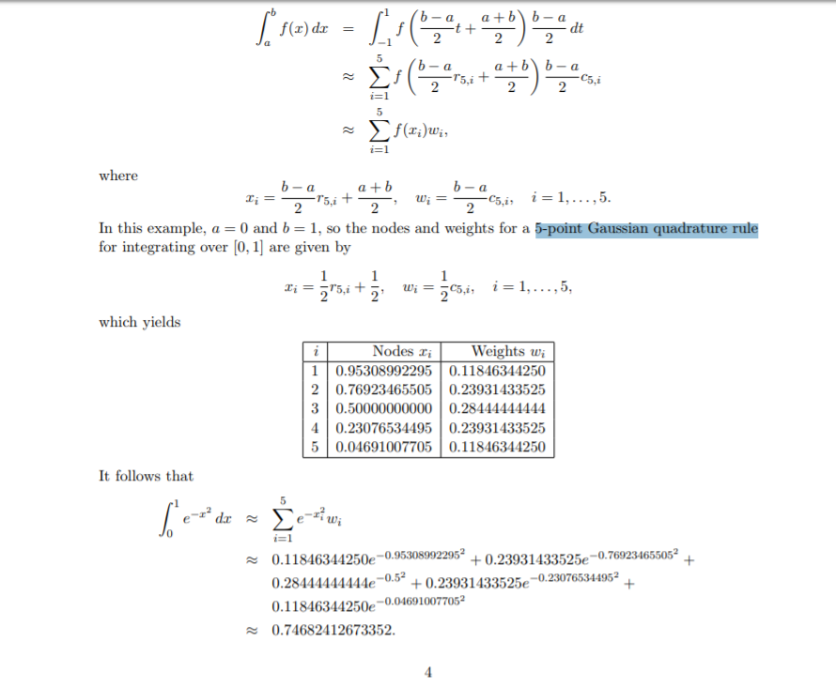
Python programming
5-point Gaussian quadrature rule
http://www.math.usm.edu/lambers/mat460/fall09/lecture31.pdf

Slide 22
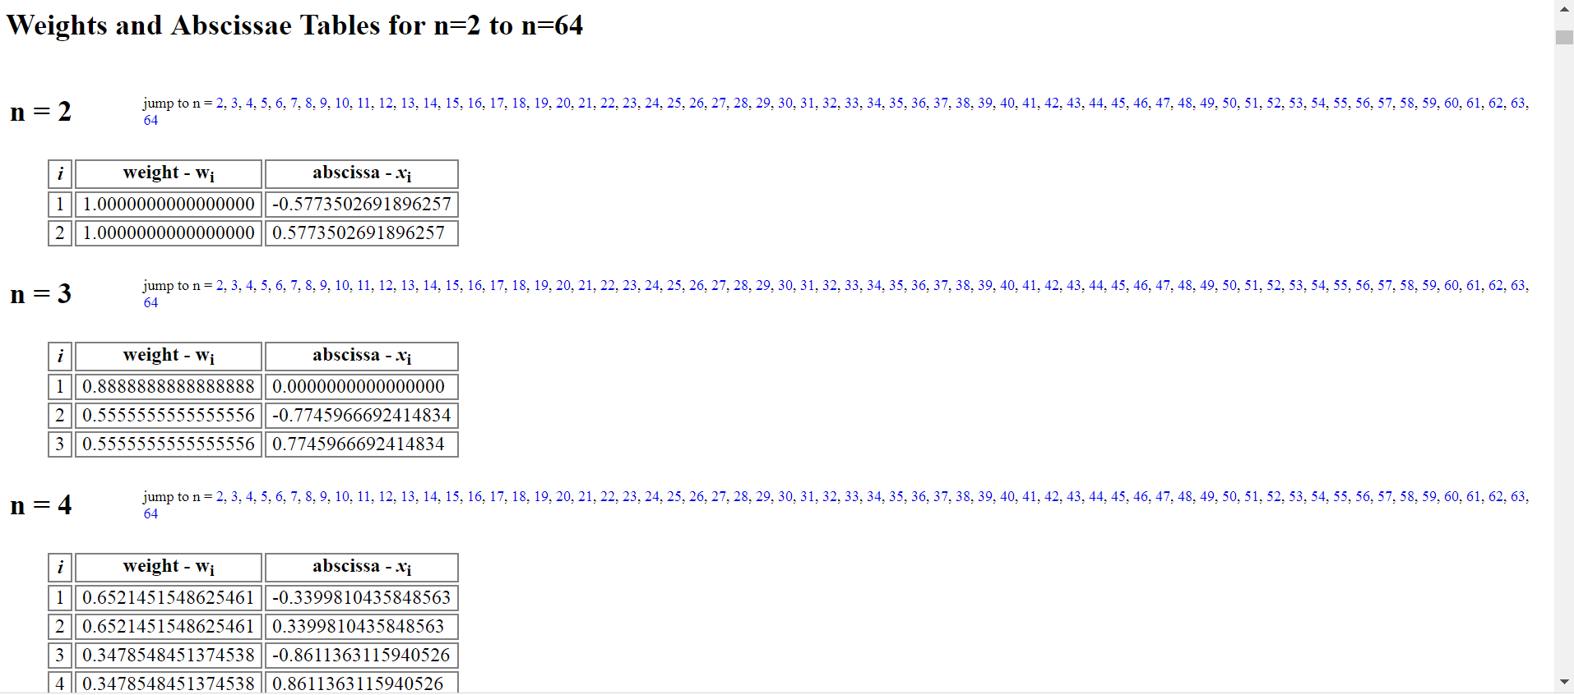
Python programming
Gaussian Quadrature Weights and Abscissae
https://pomax.github.io/bezierinfo/legendre-gauss.html

Slide 23
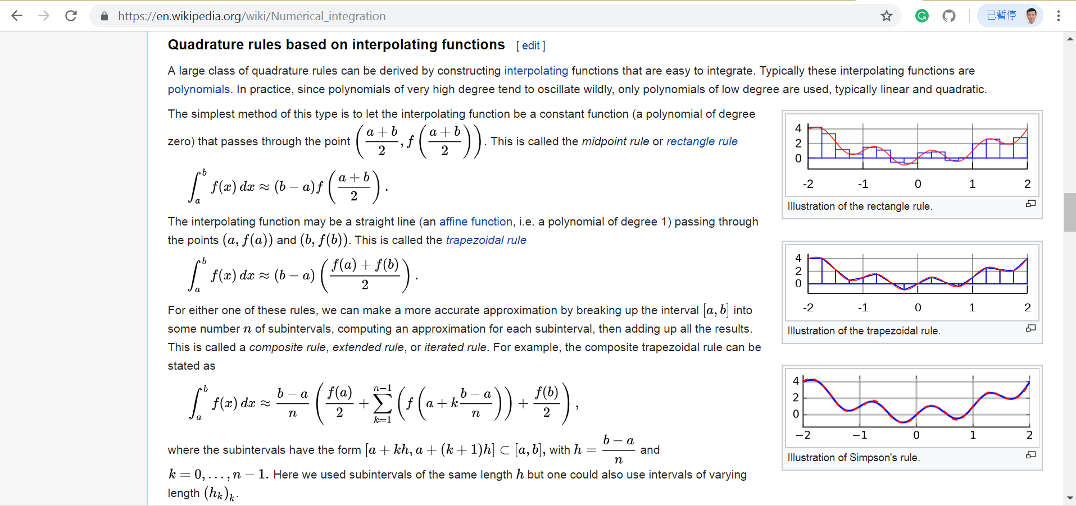
Python programming
Quadrature rules based on interpolating functions
https://en.wikipedia.org/wiki/Numerical_integration

